Slide 1
CS7/8745 : Machine Learning Instructor: Salim Sazzed Department of Computer Science University of Memphis

Slide 2
Performance Evaluation of Machine Learning Models
Evaluating the performance of machine learning models is crucial to determine how well they are performing on a given task and to compare different models.
The choice of evaluation metrics and methods depends on the type of problem you're solving (e.g., classification, regression, clustering) and the specific goals of your project.

Slide 3
Evaluation Metrics for Classification and Regression
Nature of the Target Variable:
Regression: In regression tasks, the target variable is continuous and numeric. You are predicting a real-valued quantity, such as house prices, temperature, or age.
Classification: In classification tasks, the target variable is categorical and discrete. You are predicting one of several predefined classes or categories, such as spam or not spam, disease or no disease, etc.

Slide 4
Interpretation:
Regression: Metrics in regression are typically interpreted in terms of how close the predicted values are to the actual values. For example, MAE represents the average absolute difference between predicted and actual values
Classification: Metrics in classification are interpreted in terms of the model's ability to correctly classify instances into different classes. Accuracy measures the overall proportion of correct predictions,

Slide 5
Types of Metrics:
Regression: Common regression metrics include Mean Absolute Error (MAE), Mean Squared Error (MSE), Root Mean Squared Error (RMSE), R-squared (R²), and others. These metrics focus on measuring the accuracy and precision of the predicted numeric values compared to the actual values.
Classification: Common classification metrics include Accuracy, Precision, Recall, F1 Score, Specificity, ROC Curve, AUC (Area Under the Curve), etc. These metrics assess the model's ability to classify instances into different classes and the trade-offs between true positives, true negatives, false positives, and false negatives.

Slide 6
For Classification
Accuracy: Accuracy measures the proportion of correctly classified instances in a classification task.
It is a simple and commonly used metric, but it may not be suitable for imbalanced datasets.
Suppose you have a dataset of 100 students, and you built a model to predict whether they will pass an exam or not based on their study hours.
Accuracy = (Number of Correct Predictions) / (Total Number of Predictions)

Slide 7
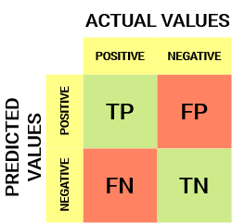
Confusion Matrix
A confusion matrix is a table or a matrix that is often used to assess the performance of a classification machine learning model.
Actual value = true value
Predicted value = prediction from model
True Positives (TP): These are instances that the model correctly predicted as positive
True Negatives (TN): These are instances that the model correctly predicted as negative
False Positives (FP): These are instances that the model incorrectly predicted as positive when they were actually negative
False Negatives (FN): These are instances that the model incorrectly predicted as negative when they were actually positive

Slide 8
2-class classification problem
Sample | Actual value | Prediction
1 | 0 | 1
2 | 1 | 1
3 | 1 | 1
4 | 1 | 1
5 | 1 | 0
6 | 0 | 1
7 | 0 | 0
8 | 1 | 1
9 | 0 | 0
10 | 1 | 0
We have 10 samples representing two classes, 0 (negative) and 1 (positive).
TP = positive value for both ground truth and prediction
TN = negative value for both ground truth and prediction
FP = = negative value for ground truth but positive value for prediction
FN = positive ground truth value but predictions says negative
TP = 4
TN = 2
FP = 2
FN = 2

Slide 9
Accuracy = (TP + TN) / (TP + TN + FP + FN)
TP = 4
TN = 2
FP = 2
FN = 2
Accuracy = (TP + TN) / (TP + TN + FP + FN)
= (4 + 2)/ (4 +2 + 2 + 2)
= 6/10
= 0.6

Slide 10
Sample | Actual value | Prediction
1 | 0 | 1
2 | 1 | 1
3 | 1 | 1
4 | 1 | 1
5 | 1 | 0
6 | 0 | 1
7 | 0 | 0
8 | 1 | 1
9 | 0 | 0
10 | 1 | 0
11 | 1 | 1
12 | 0 | 1
13 | 1 | 1
Compute-
true positive (TP), true negative (TN), false positive (FP), and false negative (FN) and accuracy
Accuracy = (TP + TN) / (TP + TN + FP + FN)

Slide 11
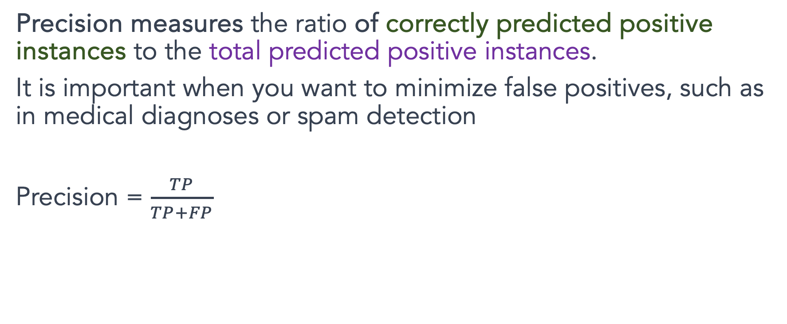
Precision:
Precision measures the ratio of correctly predicted positive instances to the total predicted positive instances.
It is important when you want to minimize false positives, such as in medical diagnoses or spam detection
Precision = $\frac{TP}{TP+FP}$

Slide 12
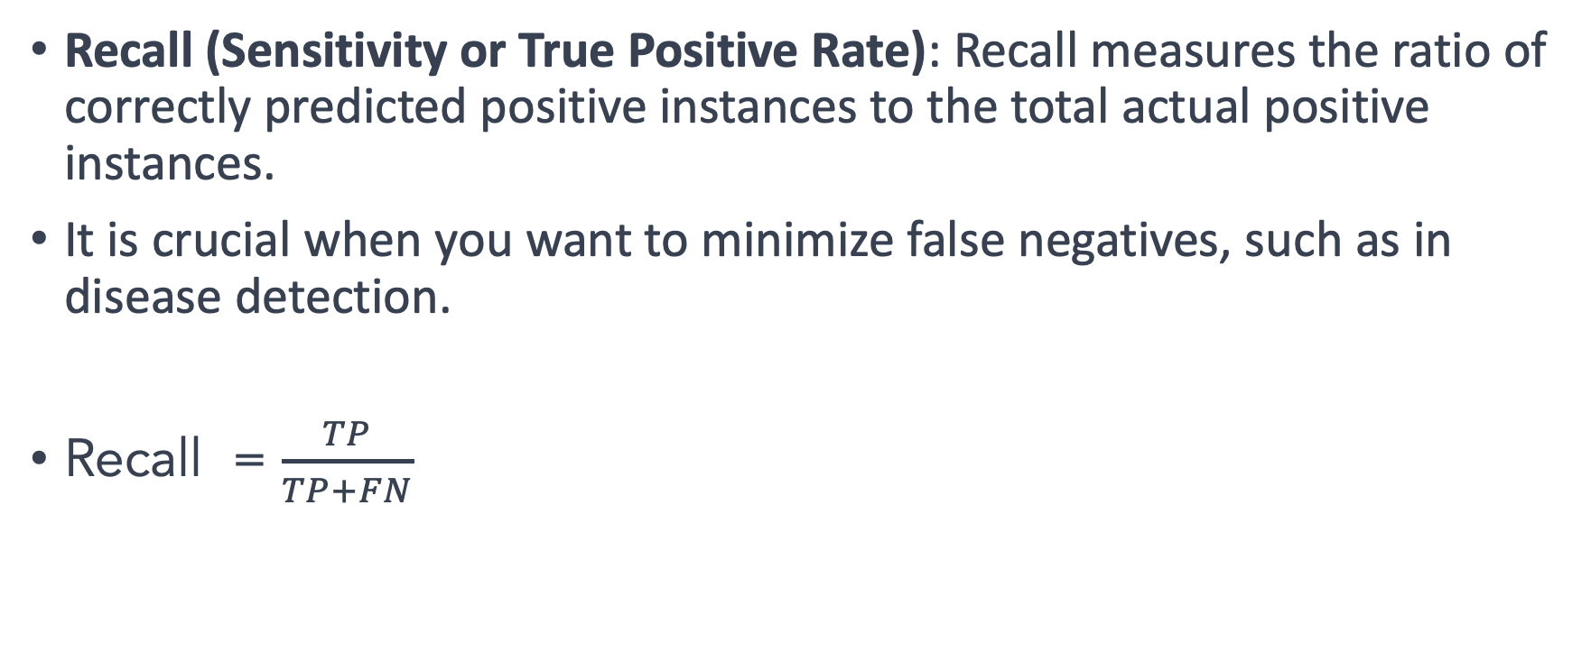
Recall
Recall (Sensitivity or True Positive Rate): Recall measures the ratio of correctly predicted positive instances to the total actual positive instances.
It is crucial when you want to minimize false negatives, such as in disease detection.
Recall = $\frac{TP}{TP+FN}$

Slide 13
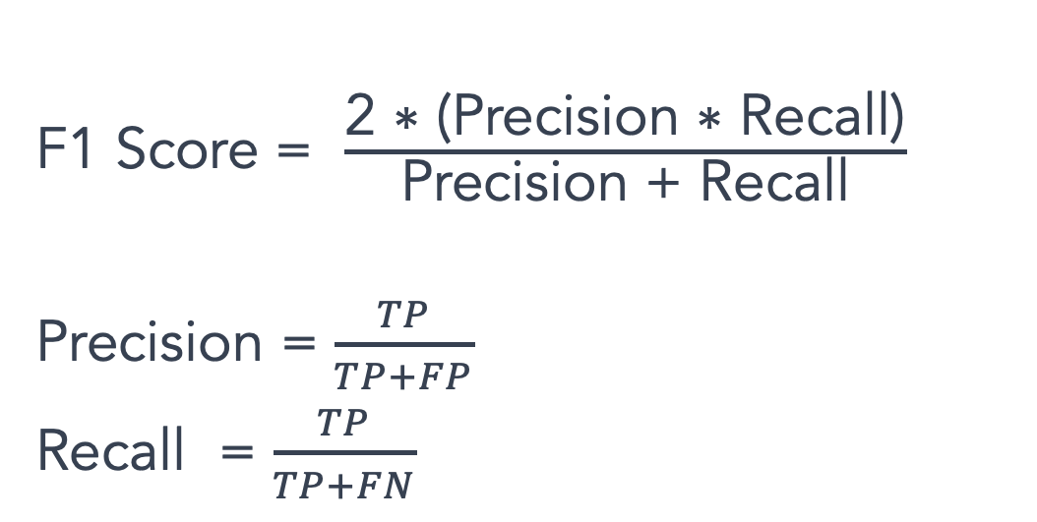
F1 score: The harmonic mean of precision and recall, providing a balanced measure of a model's performance.
Sample | Actual value | Prediction
1 | 0 | 1
2 | 1 | 1
3 | 1 | 1
4 | 0 | 0
5 | 1 | 0
6 | 0 | 1
7 | 0 | 0
8 | 1 | 1
9 | 0 | 0
10 | 1 | 1
11 | 1 | 1
12 | 1 | 0
13 | 0 | 1
F1 Score = $\frac{\text{2 ∗ (}\text{Precision}\text{ ∗ }\text{Recall}\text{)}}{\text{Precision}\text{ + }\text{Recall}}$
Precision = $\frac{TP}{TP+FP}$
Recall = $\frac{TP}{TP+FN}$
Compute F1 score

Slide 14
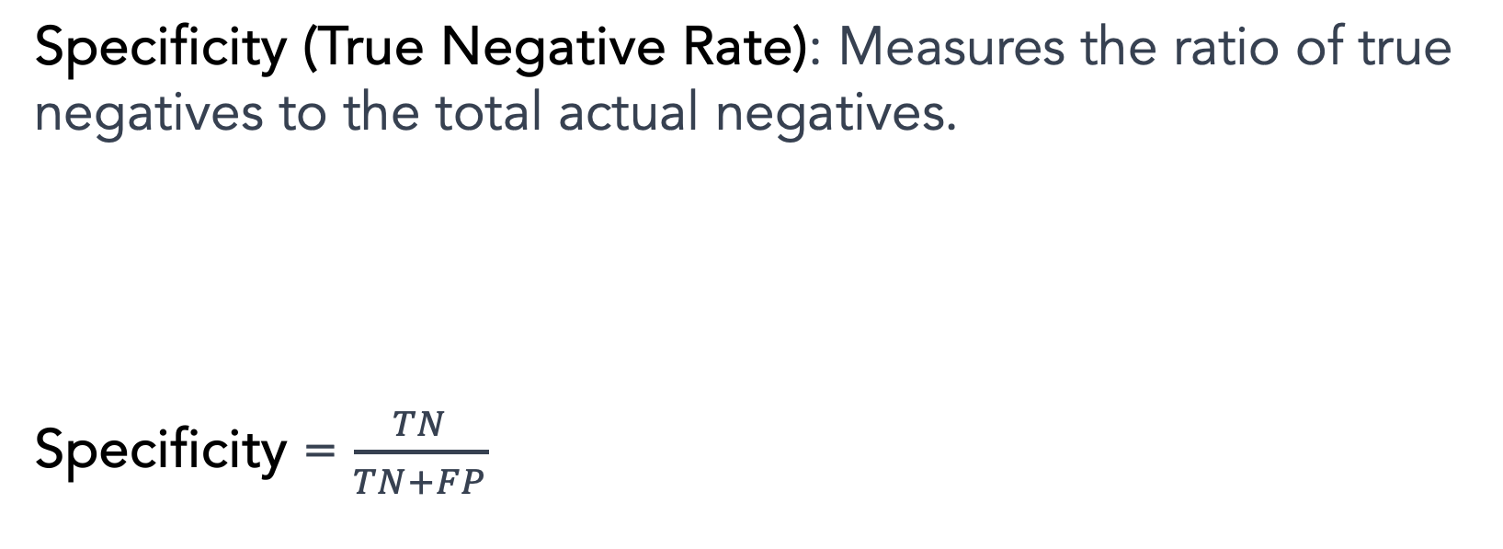
Specificity (True Negative Rate): Measures the ratio of true negatives to the total actual negatives.
Specificity = $\frac{TN}{TN+FP}$

Slide 15
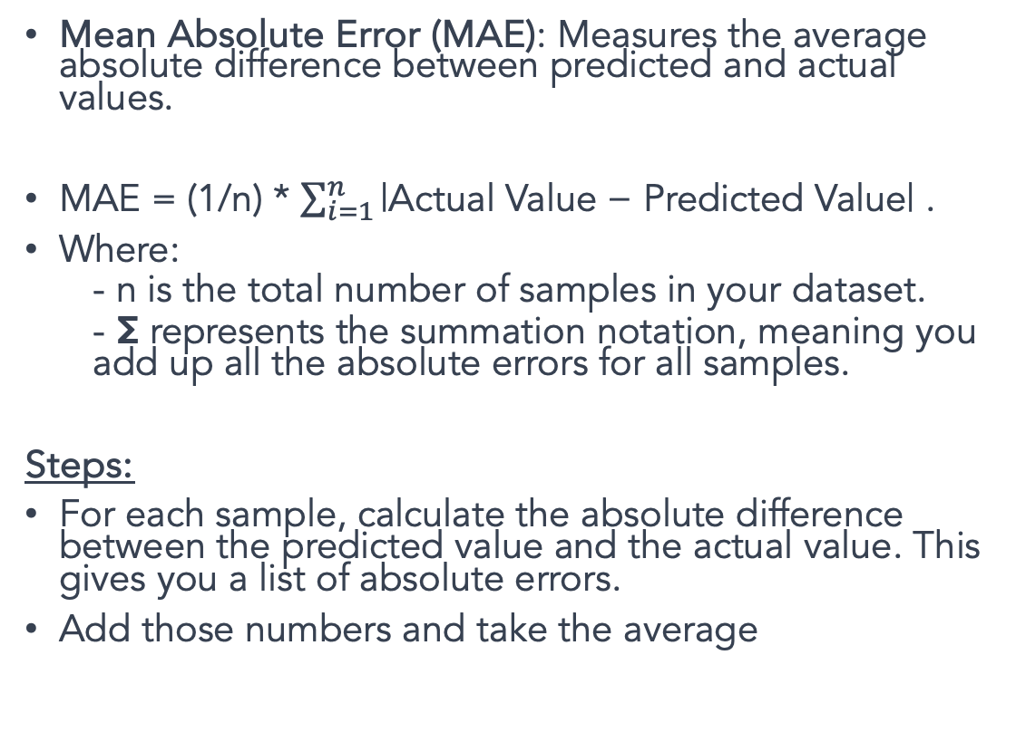
Metrics for Regression
Sample | Actual value | Prediction
1 | 5 | 3
2 | 4 | 6
3 | 3 | 9
4 | 2 | 0
5 | 7 | -5
6 | 2 | -1
7 | 4 | 0
8 | -3 | -1
9 | 3 | 3
10 | 4 | 6
Mean Absolute Error (MAE): Measures the average absolute difference between predicted and actual values.
MAE = (1/n) * $\sum_{i=1}^{n}{\text{|}\text{Actual} \text{Value}\text{ − }\text{Predicted} \text{Value}\text{| }}$.
Where:
- n is the total number of samples in your dataset.
- Σ represents the summation notation, meaning you add up all the absolute errors for all samples.
Steps:
For each sample, calculate the absolute difference between the predicted value and the actual value. This gives you a list of absolute errors.
Add those numbers and take the average

Slide 16
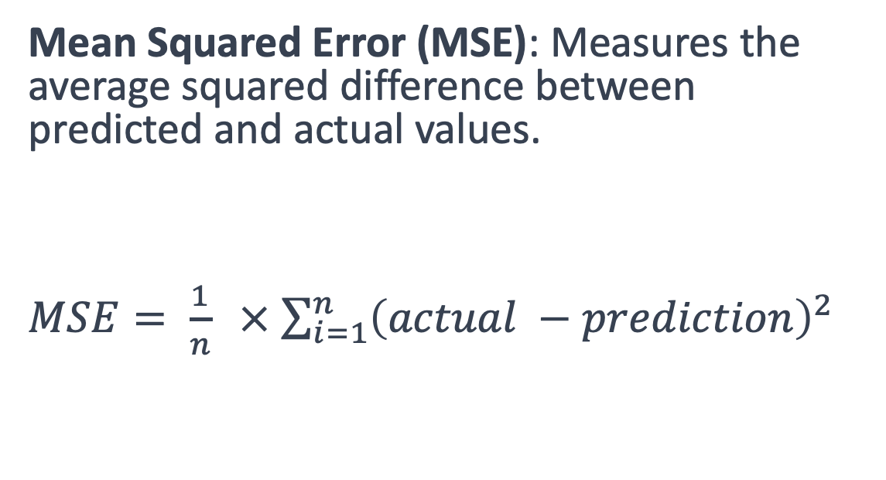
Sample | Actual value | Prediction
1 | 5 | 3
2 | 4 | 6
3 | 3 | 9
4 | 2 | 0
5 | 7 | -5
6 | 2 | -1
7 | 4 | 0
8 | -3 | -1
9 | 3 | 3
10 | 4 | 6
Mean Squared Error (MSE): Measures the average squared difference between predicted and actual values.
$MSE= \frac{1}{n} ×$ $\sum_{i=1}^{n}{{\left(actual −prediction\right)}^{2}}$

